Slide 1
DATA Challenge
Executive Office of Technology Services and Security (EOTSS)
Sanjana Nandy​

Slide 2
AGENDA
Introduction​
Approach
Insights
​Summary​

Slide 3
Introduction
The City of Goodeats is committed to enhancing its food safety inspection process and the overall performance of food establishments.
"Are there commonalities or trends among establishments that perform poorly?”
Examining patterns and trends among establishments to identify common factors contributing to their underperformance. These inspection criteria may further help in understanding the areas that require attention and improvement.
Food Service license categories:
Eating and Drinking Establishment (e.g. restaurant)
Eating and Drinking Establishment with Take-Out Service
Mobile Food Truck or Vendor
Retail Food Establishment (e.g. grocery or convenience store, etc.)
Notes:
For the purpose of this analysis, I focused on one specific aspect from the provided bullet points: "Are there commonalities or trends among establishments that perform poorly?" By examining patterns and trends among establishments that consistently receive poor inspection grades, we can identify common factors contributing to their underperformance. Factors such as food establishment types (e.g., restaurants, fast-food chains), violations types, or specific inspection criteria may shed light on areas that require attention and improvement.

Slide 4
Approach
Purpose
Question
Dataset
Data Preprocessing
Insights Dashboarding
Understand purpose of the analysis;
Generate insights for City’s food Inspection process, results
“Are there commonalities or trends among establishments that perform poorly?”
Food establishment violations
Food establishment grades
Data Cleaning,
Data Exploration
Tools: MS Excel, Python
Utilize charts to visualize the insights and conclude
Tools: Tableau, Python

Slide 5
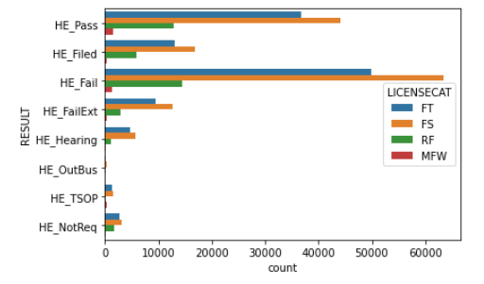
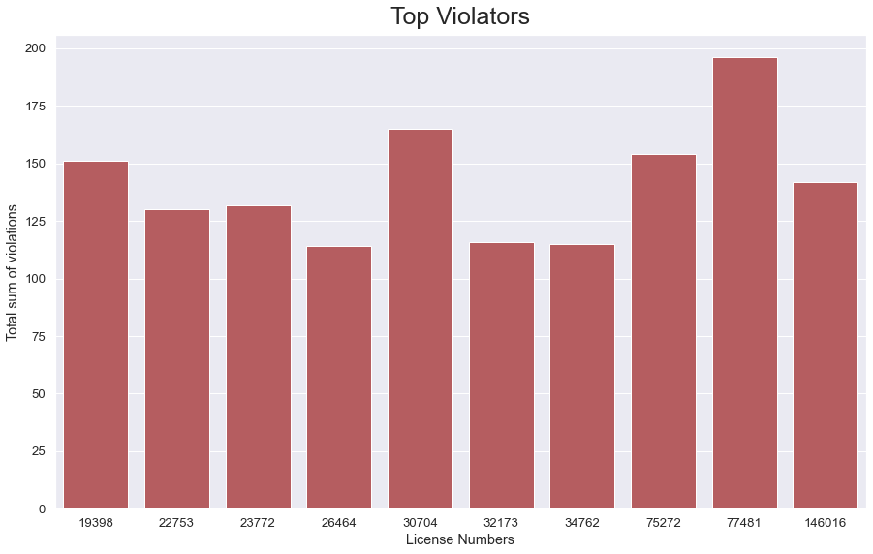
Data Exploration
Understood the dataset using the data dictionary files
Data Merging – violation and grade
Removed duplicate values
Recognized and Filtered out Result categories –
- Inspection Passed
- Inspection Failed
- Re-inspection Failed,
- Inspection did not pass but inspector declines to re-inspect
- Restaurant temporarily shut down by order of Health Department Establishment must have hearing to determine whether it can reopen/keep its license
- The establishment has gone out of business
- Inspection is not required
Top violators based on the sum of points food establishments received in severity of the violations
foodborne critical violation (***) = 10 points
critical violation (**) = 7 points
non-critical violation (*) = 2 points
Ex, if the inspection resulted in 2 foodborne critical violations and 2 non-critical violations,
Sum of violations = (2*10) + (2*2) = 24

Slide 6
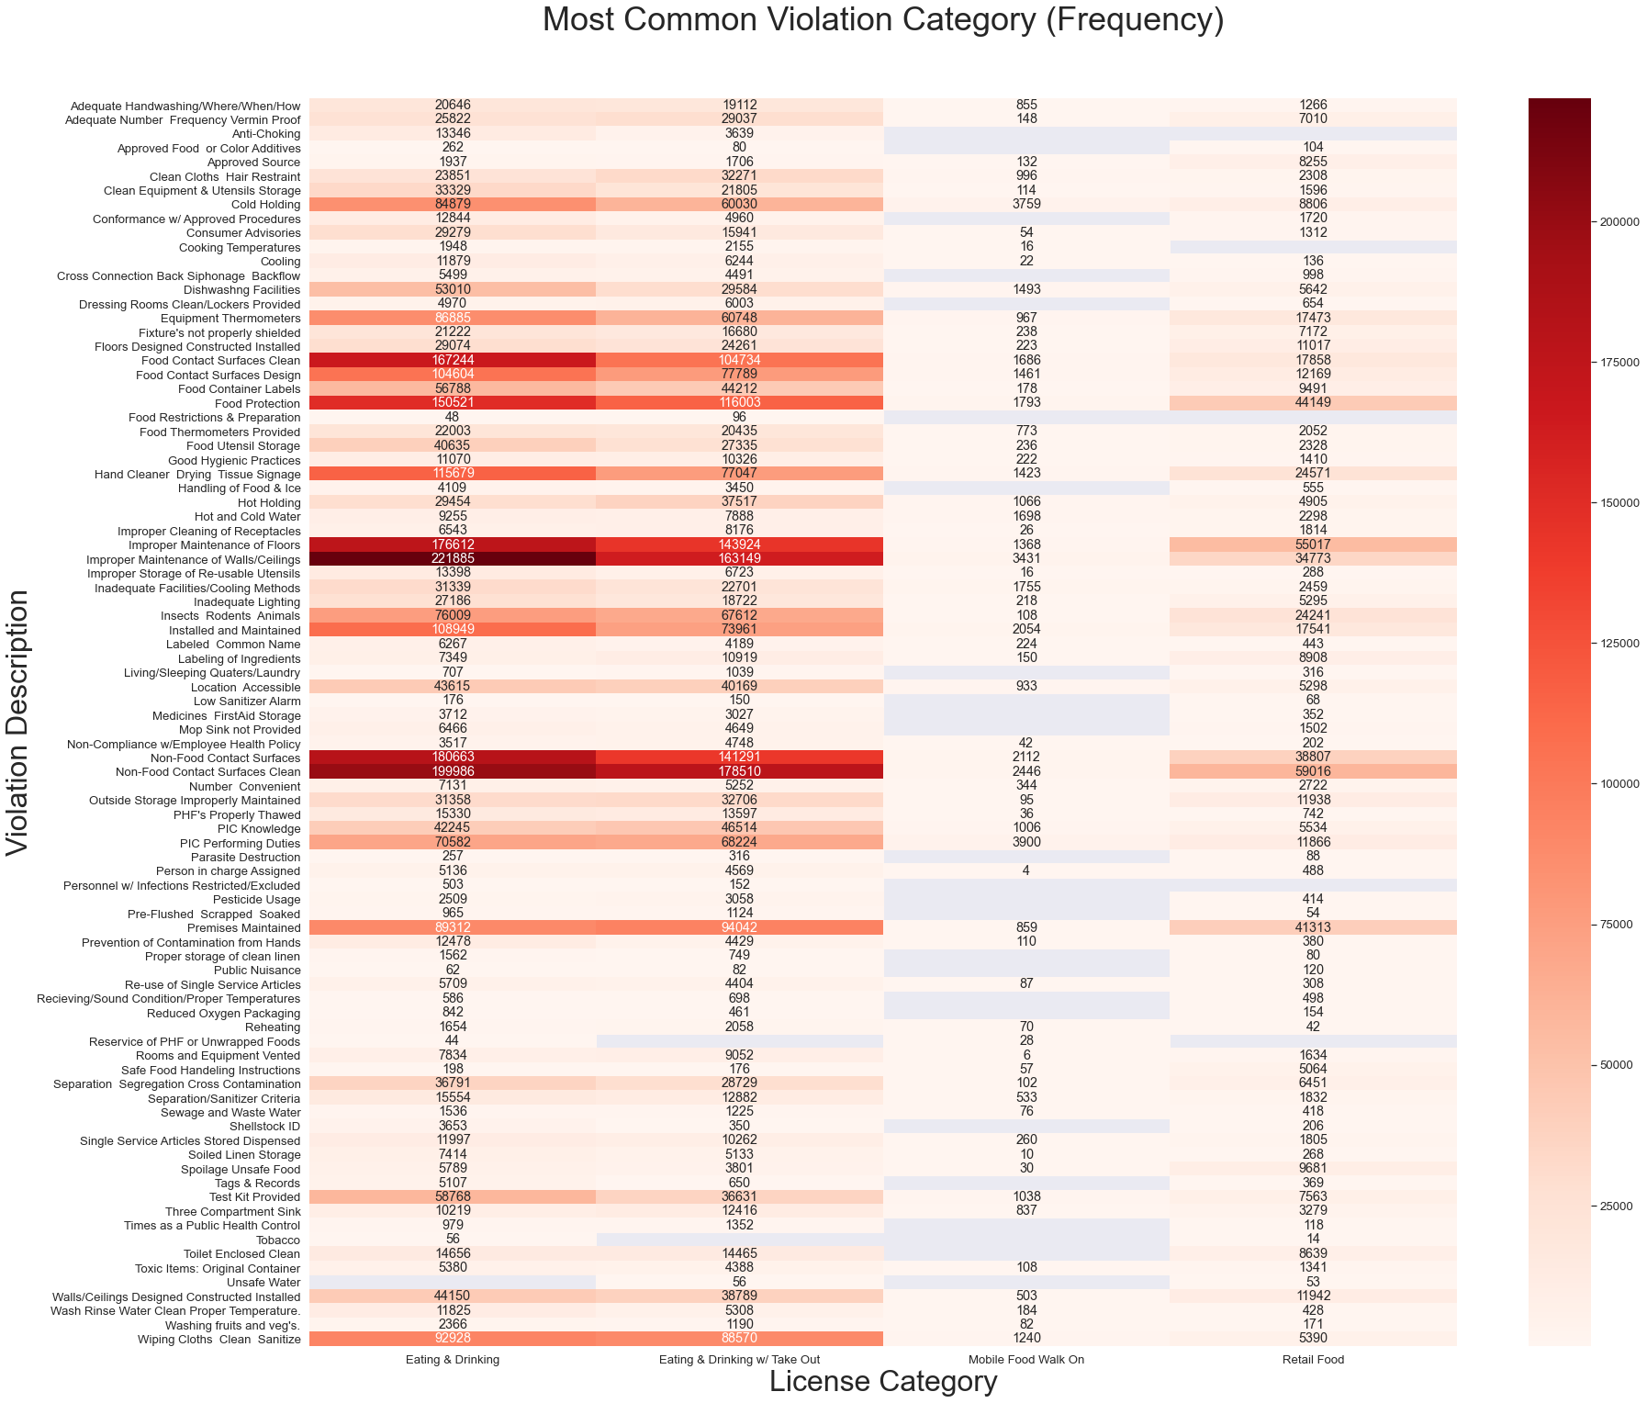
MOST COMMON VIOLATION CATEGORY (based on Frequency)
Here, for Eating and Drinking Establishments has common violation category as
Improper Maintenance of Walls/Ceilings
Improper Maintenance of Floors
Food Protection
Non-Food Contact Surfaces
Food Contact Surfaces Design

Slide 7
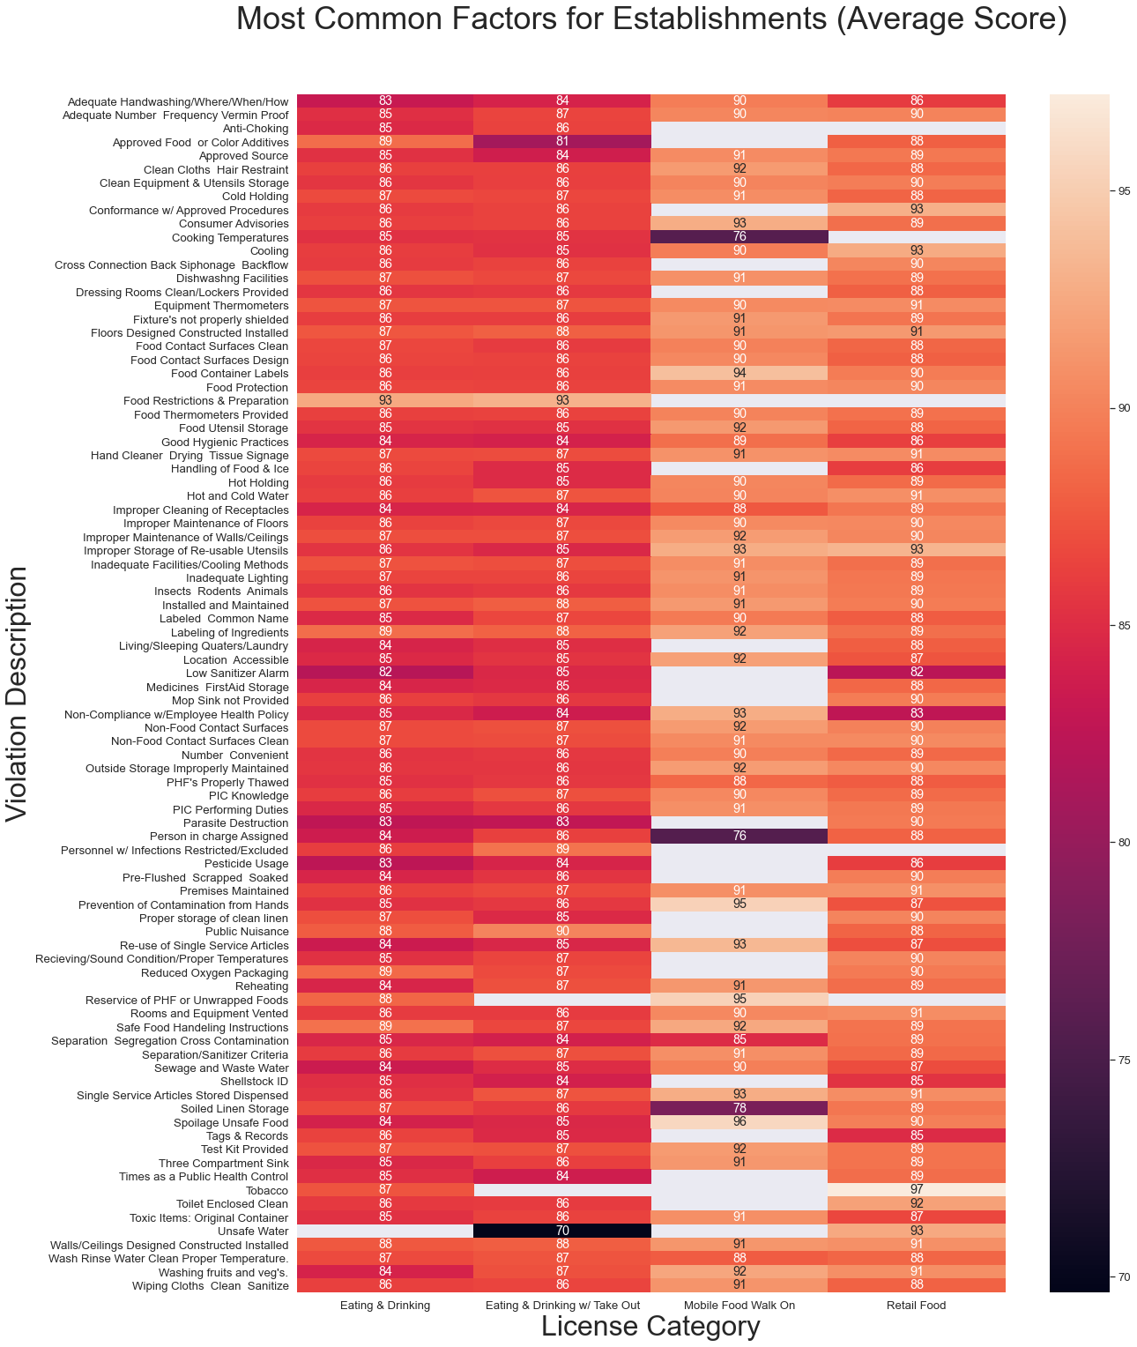
MOST COMMON VIOLATION CATEGORY (based on Average Score)
Here, for Retail Food Establishments has better performance with Average score in the range 85 to 97
These are some contributing factors for violations,
Toxic Items: Original Container
Handling of Food & Ice
Non-Compliance w/Employee Health Policy
Shellstock ID

Slide 8
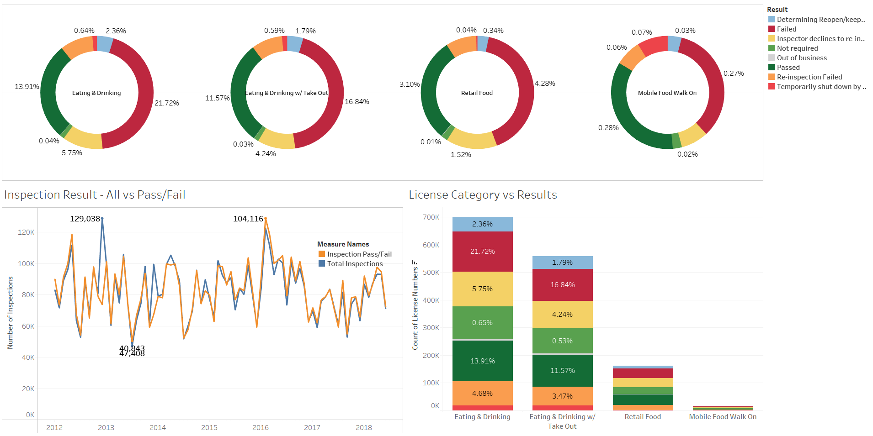
Inspection Analysis based on License Category and Result

Slide 9
These charts Represent the result of the inspection as determined by the health inspector.
Here, Eating and Dinking Establishment,
13.91% Passed
2.36% Determining Reopen/keep its license
0.04% Inspection not required
Represent the Inspection trend showcasing the total inspections vs Inspection Pass and Failed
Distribution for each license category

Slide 10
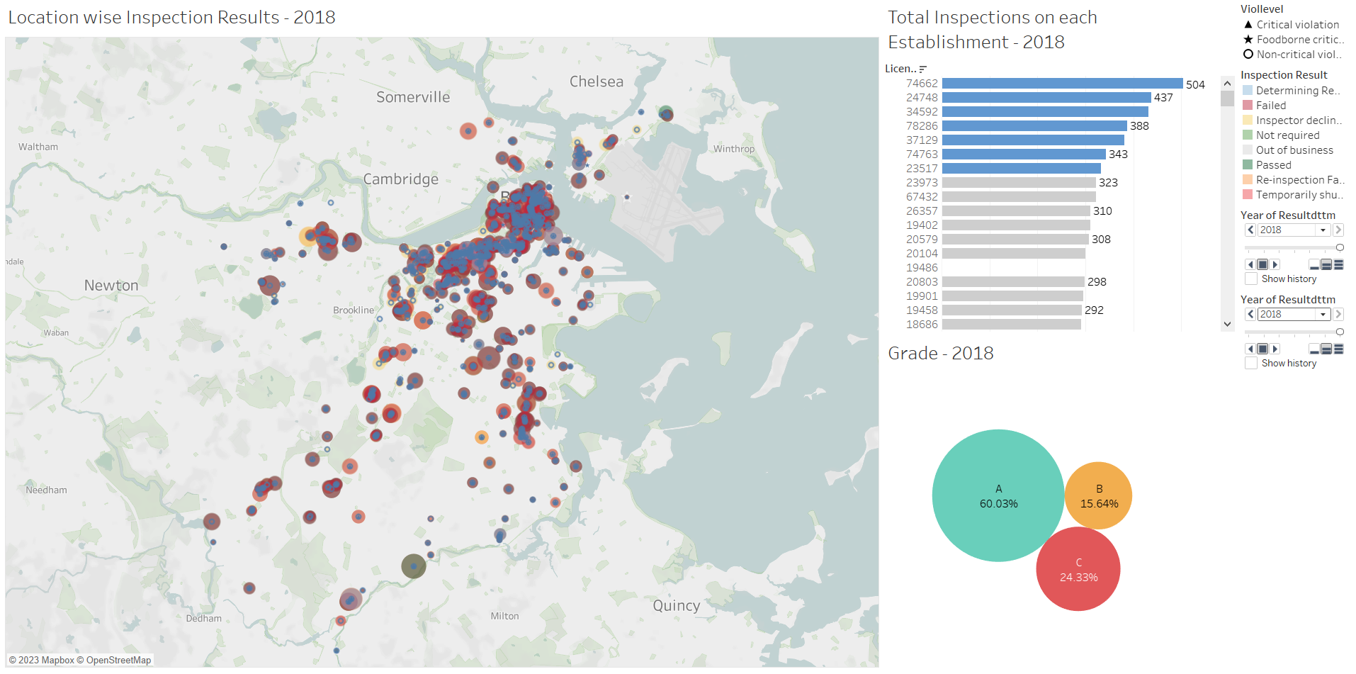
Location wise distribution and trend over years

Slide 11
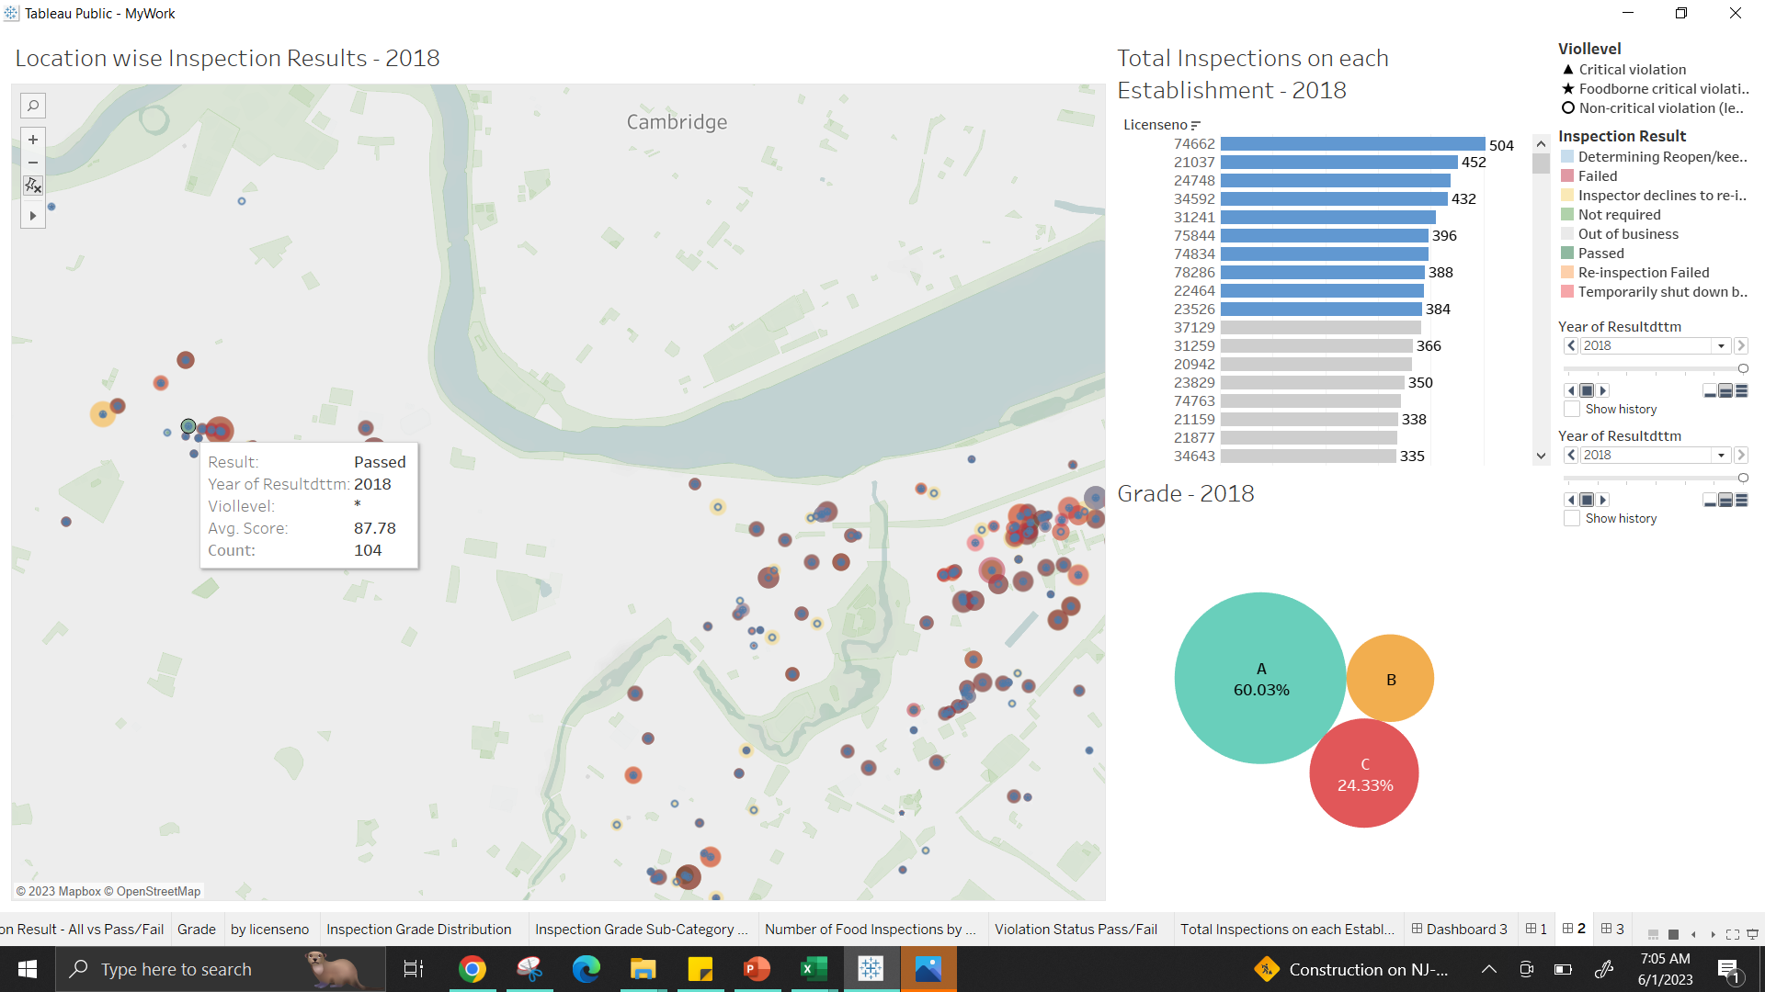
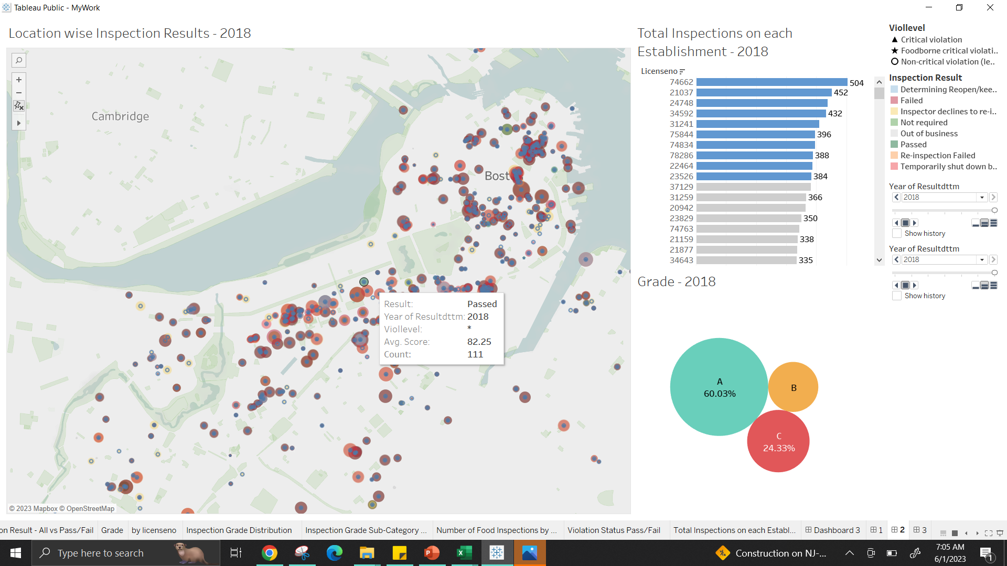
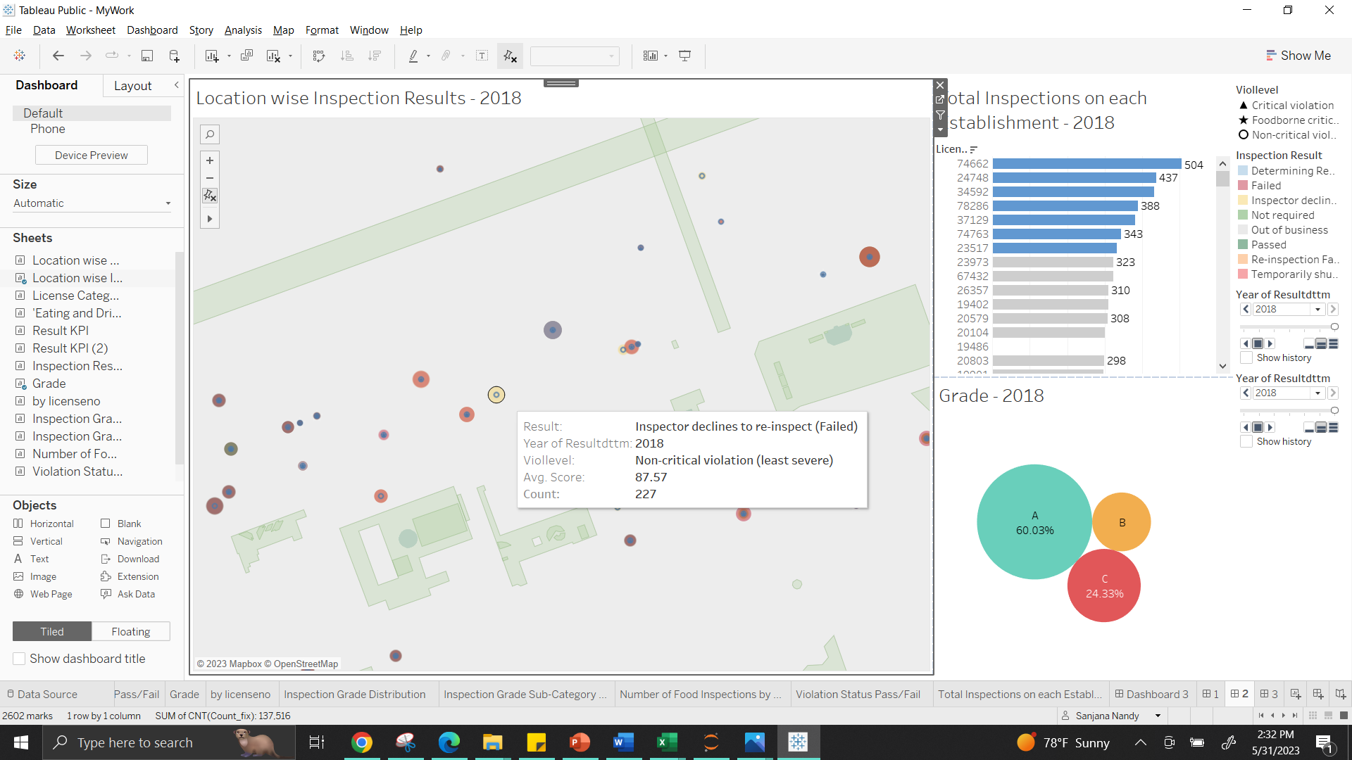
Represents total inspections performed on the food establishment ( for the given license number)
Grade distribution as A,B, C based on scores
A = SCORE>=94
B = SCORE>=81 AND SCORE<=93
C = SCORE<=80
Inspection results as Passed for non-critical violation (least severe) for the given location. Inspection performed 111
Inspection Results as inspector declines to re-inspect for year 2018 with severity level as non-critical (least severe)

Slide 12
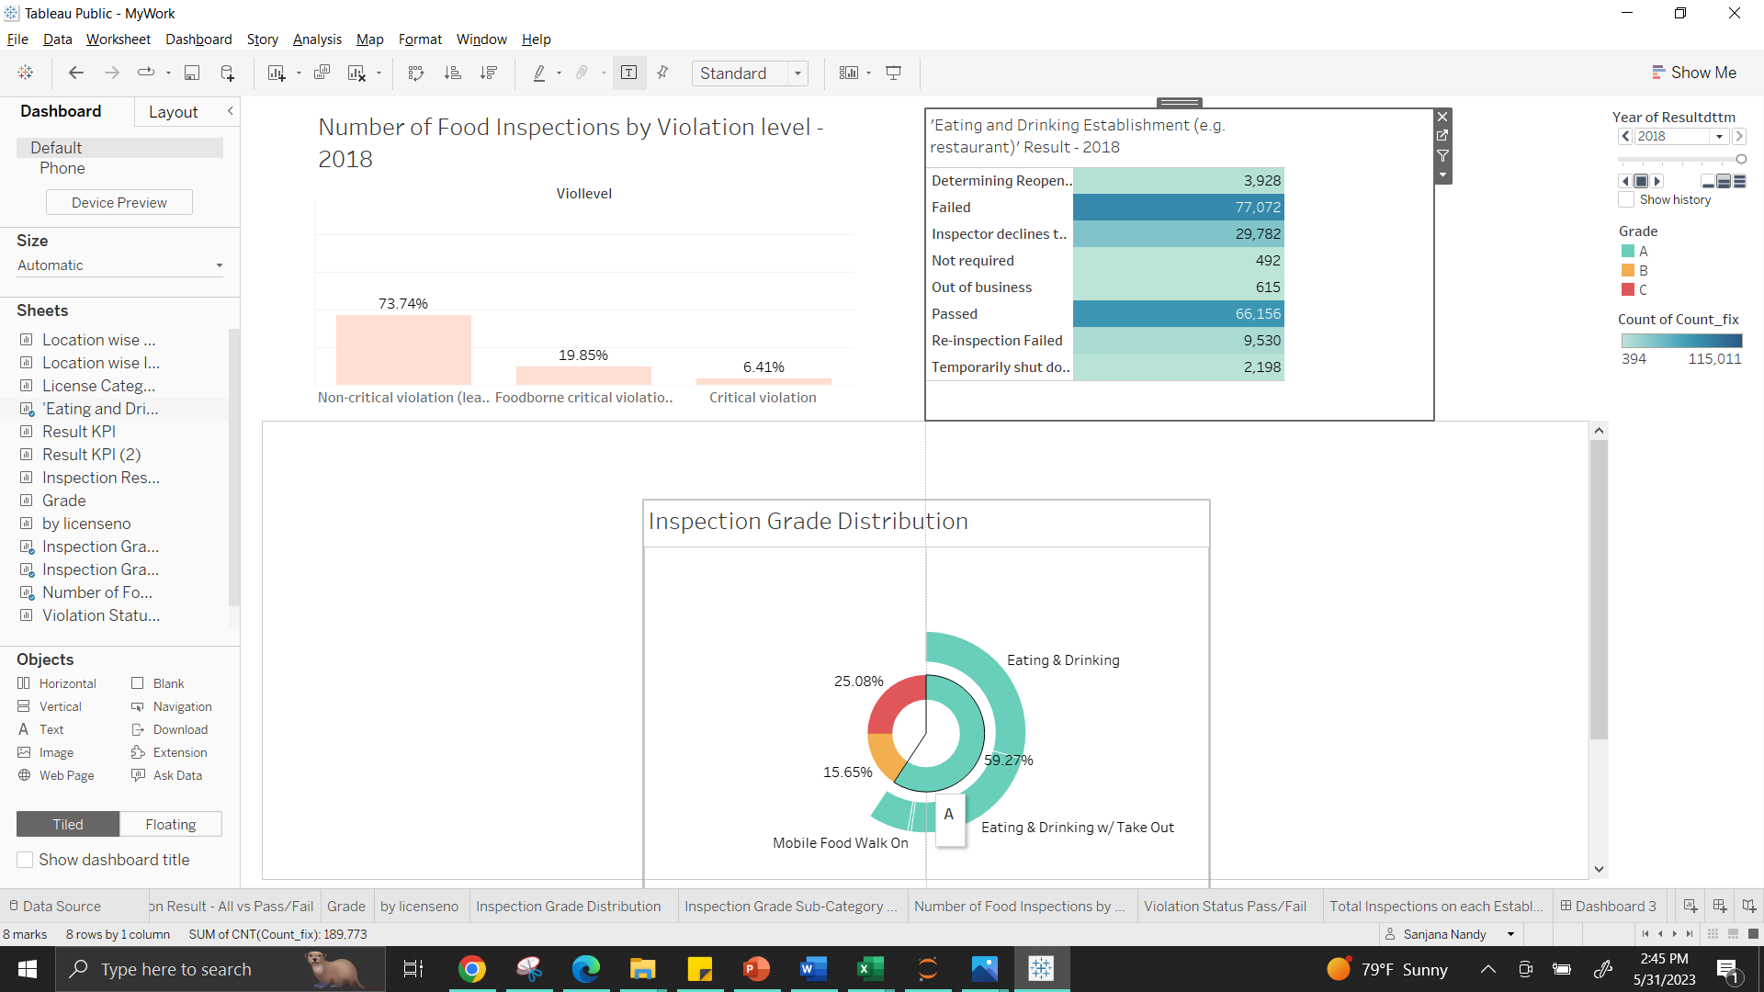
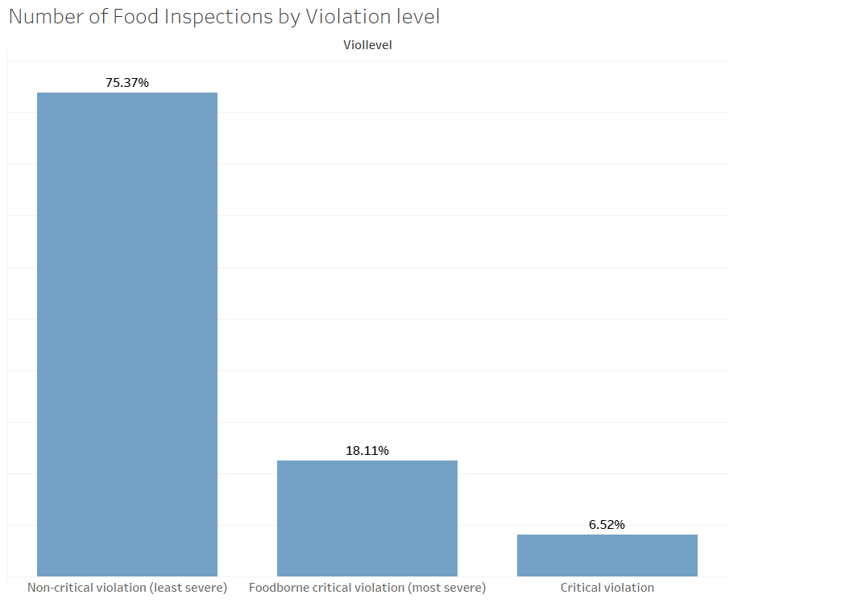
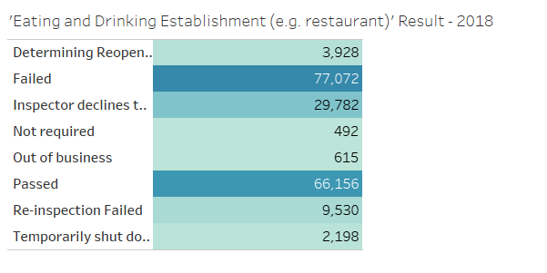
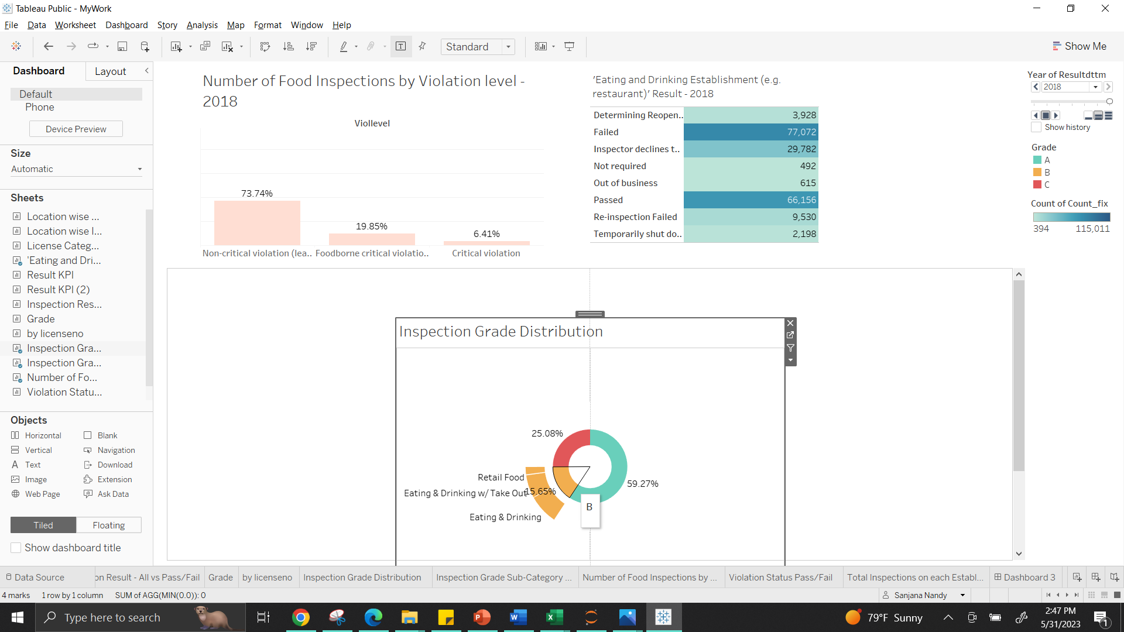
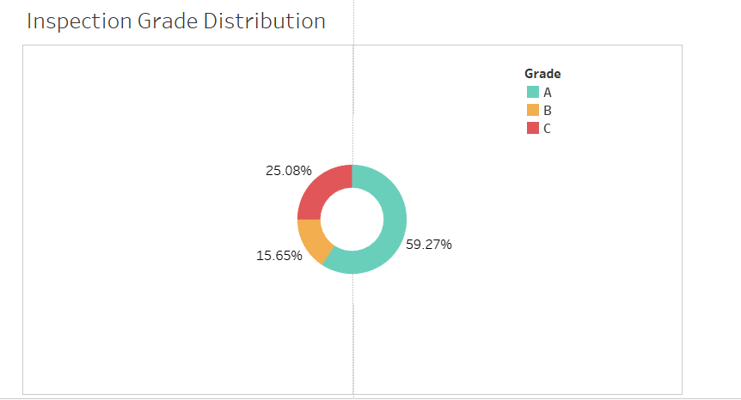
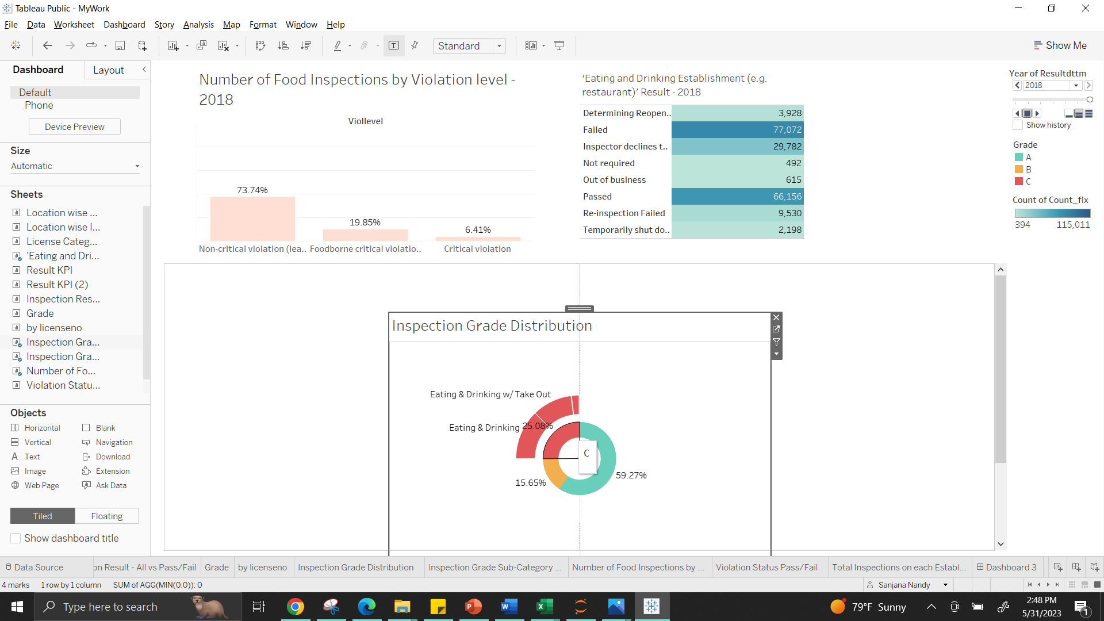
Grade Distribution for each License Category
Food Inspection Violation levels Distribution
Inspections Result distribution for ‘Eating & Drinking Establishment’
Food Inspection violations based on the severity of violation (defined by the FDA Food Code, v. 2009)

Slide 13
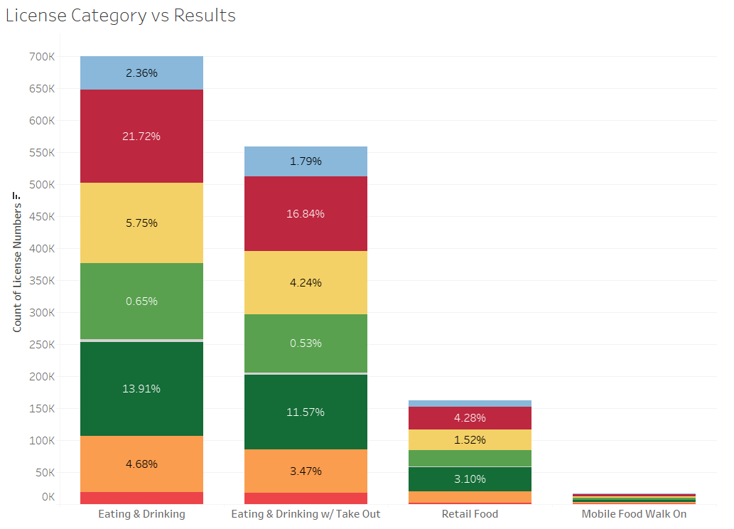
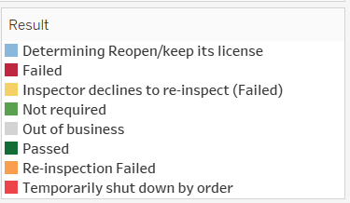
Are there commonalities or trends among establishments that perform poorly?
statement of main finding
Most Inspected Food Establishment: Eating and Drinking Establishment (e.g., restaurant)
Most Severe Violations: Eating and Drinking Establishment (e.g., restaurant)
Most Failed Results based on initial and Re-inspections: Eating and Drinking Establishment (e.g., restaurant)

Slide 14
SUMMARY
Establishments are continuously inspected and scored based on there performance.
The inspections for Eating and Drinking Establishment consistently receive poor inspection grades, as identified common factors contributing to their underperformance from the earlier insights.
These inspection criteria's further help in understanding the areas that require attention and improvement.
From the earlier insights, Inspection on ‘Eating and Drinking Establishment’ had severe violations with majority of failed Inspection results.
There are various factors which contribute to the inspection results- food hygiene, Installation maintenance, Establishment arrangements.

Slide 15
THANK YOU
Sanjana Nandy

Slide 16
Appendix

Slide 17
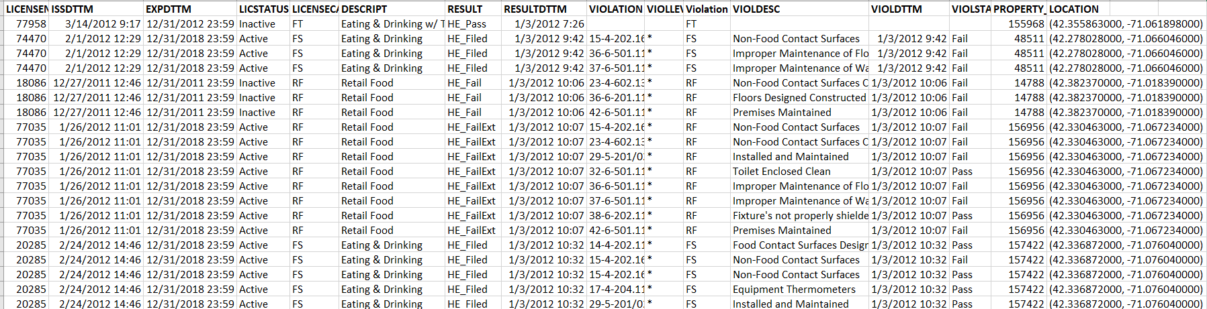
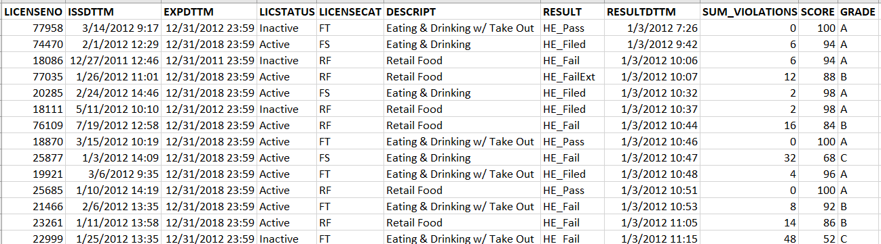
Dataset
Violation:
Grade:

